Slide 1
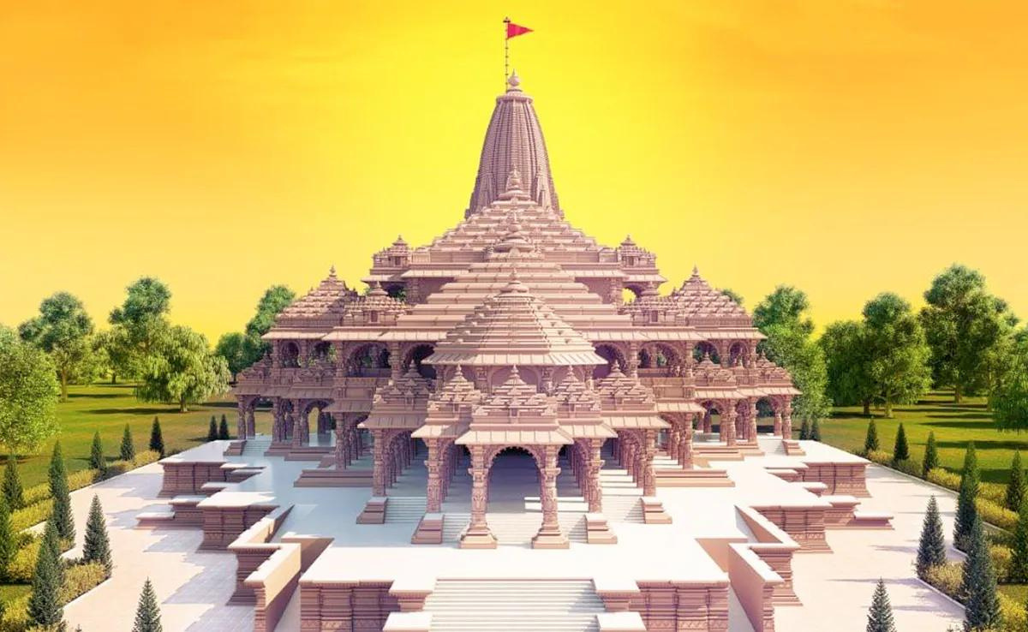

SHRI RAM JANMBHOOMI
AYODHYA

Slide 2

NAME:LEEPY SHAH
ENROLL NO:22002170110167
ROLL NO:114
BATCH:A4
BRANCH:CE

Slide 3


TABLE CONENT
1.INRODUCTION
2.FUNCTIONALITY
3.STRONG POINT
4.FUTURE SCOPE

Slide 4

INRODUCTION
shri raam janmabhoomi ayodhya
Recently, on 22nd January, we celebrated a monumental event - the construction of the Shri Ram Mandir in Ayodhya.
"After a century-long endeavor, the dream of building the Shri Ram Mandir finally became a reality."
As the name suggests, the temple is dedicated to Lord Shri Rama and is believed to have been built at Ram Janmabhoomi (the birthplace of Lord Shri Rama).

Slide 5


FUNCTIONALITY
Navigation Bar
Home Section:
Progress Bar:
Lord Ram Section:
The navigation bar allows users to easily navigate between different sections of the website using anchor links.
It includes links to sections like Home, Temple, Lord Ram, Our Souvenir, and Tourism.
.
The home section features a full-screen video background showcasing the essence of the event.
It provides a brief introduction to the Shri Ram Mandir and its significance as the birthplace of Lord Ram.
Includes a carousel displaying images related to the temple and its surroundings.
A progress bar indicates the completion status of the temple construction.
Provides textual information about the progress made in the construction process
Displays cards featuring images related to different chapters (kands) from the Ramayana, such as Bal Kand, Ayodhya Kand, Aranya Kand, etc.

Slide 6
FUNCTIONALITY
Our Souvenir Section:
Tourism Section:
Footer :
Showcases a carousel of videos highlighting different aspects of the Shri Ram Mandir, including its history, souvenirs, and festivities.
Each video card includes a title, description, and a link to explore more details.
.
Provides information about tourism options and transportation to Ayodhya.
Includes details about travel by air, train, and road, along with nearby airports and railway stations.
Features a Google Maps embed to visualize the location of Ayodhya.
The footer contains social media links for easy access to the website's social profiles.
It includes copyright information and credits for the website's development.

Slide 7


STRONG POINTS
.Clear Navigation
Informative Content
Engaging Visuals
Multimedia Integration:
Accessibility
Overall, the code effectively combines informative content, engaging visuals, and interactive elements to create a compelling and user-friendly website experience for visitors interested in learning about and exploring the Shri Ram Ayodhya event.

Slide 8
INTEGRATION
Live Construction Updates
Virtual Tours
implementing additional accessibility features such as keyboard navigation, screen reader compatibility, and text resizing options would ensure that the website is inclusive and accessible to users with disabilities. Prioritizing accessibility enhancements can help improve user experience for all visitors.
User Feedback
Multilingual Support
Social Media Integration
Enhanced Accessibility Features

Slide 9

THANKYOU
presented by: LEEPY SHAH
1 April 2024 | FSD project

